Slide 1
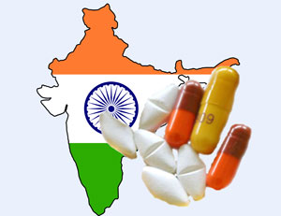
Patented Medicines vs. Right to Health
AICTE SPONSORED ONE DAY
NATIONAL SEMINAR: IPRPL-2012
Greater Kolkata College of Engineering and Management, Kolkata
25 Aug. 2012
© Harshavardhan Yadav (JSD)
National University of Study and Research in Law, Ranchi

Slide 2
The Presentation
Historical Background
Product Patent & Access to Drug
Harmonizing Conflicting Interests
Initiatives that the Government needs to take

Slide 3
Historical Background
The Indian Patents and Designs Act ,1911 was fairly liberal as patenting of products related to foods, pharmaceutical, chemicals, etc. was available with a full term of 16 years in India.
Indian Patents Act of 1970 explicitly disallows product patents for "substances intended for use, or capable of being used, as food or as medicine or drug.“

Slide 4
CONT…..
Later in 1994, WTO was born effective 1st January 1995, where India was also a founder signatory.
WTO activated many agreements. Important among all of them is, of course the TRIPs Agreement. TRIPs has asked for harmonization of Intellectual properties protection among member states.

Slide 5
CONT….
Countries that are members of the WTO agree to certain common standards in the way they enact and implement their patent laws. These standards include, amongst others, that patents be given for a minimum of 20 years; that patents may be given both for products and processes.
The three consecutive amendments in 1999, 2002, 2005 under Indian Patent Act 1970 to comply with TRIPs obligation.
1st January 2005, drug product patent protection has been reintroduced in India.
The product patent prohibits others from making, using, offering for sale, selling or importing the patented product.

Slide 6
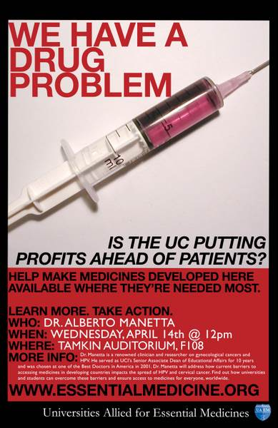
Product Patent & Access to Drug
Health is one of the fundamental basic needs of all human being.
The Constitution recognize that the right to health would encompass a number of elements from prevention to cure to access to drugs.
Drug companies often abuse the patent monopoly and fix exorbitant prices for the patented medicines.
Reduces Accessibility and Affordability of drugs.

Slide 7
Harmonizing Conflicting Interests
A tussle between the monopoly right conferred via Intellectual Property legislations and the Right to health specially right to access the drug.
WTO Doha Declaration on TRIPS Agreement and Public Health (2001), in which, inter alia, observed that countries have the sovereign right to enact laws that safeguard domestic interests & recognized that member countries had the right to protect public health and to promote access to medicines for all.

Slide 8
CONT….
Compulsory licensing has used as a tool to regulate the exclusive rights conferred by patents.
India has the widest compulsory licensing norms that the world has ever known.
In March 2012, India granted its first compulsory license, allowing a domestic drug maker to manufacture generic version of Nexavar, a cancer drug by Germany's Bayer. That enabled India's Natco Pharma to sell its generic version of Nexavar at INR 8,800 rupees ($160) per monthly dose, a fraction of the INR 280,000 ($5090) rupees Bayer's version cost.

Slide 9
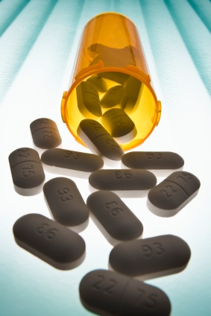
Initiatives that the Government needs to take
Drug Subsidies:
Subsidies should granted in cases of drugs, in the same manner as they are granted in LPG, petrol, Kerosene oil, sugar and other essential commodities.
Price Control Mechanism:
Nearly 75% of the retail pharma market is currently outside price control.
Price Ceilings:
The ceiling on the prices will ensure that the maximum price of a particular drug is well within the reach of the masses.

Slide 10
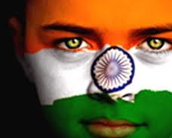
Thank You

